Slide 1
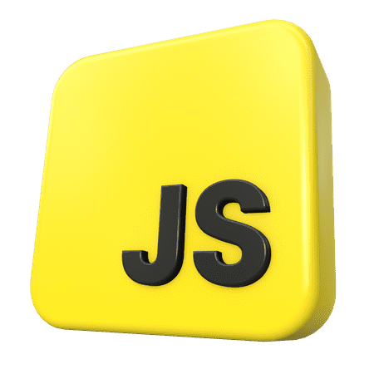
Basic Syntax
01
02
JavaScript Language
Data Types & Variables
03

Slide 2
Content
04
01
Course Introduction
05
02
Hello World!
06
03
Data Types and Variables

Slide 3
Content
01
02
03
04
Functions
05
Common Mistakes
06
Operations

Slide 4

Ivaylo Papazov

Slide 5
01
Course Introduction
What is Programming, IDE, source code

Slide 6
Schedule
Essentials Syntax
Basic Syntax
Algorithmic Thinking
Entry Exam
Foundation Knowledge
HTML & CSS
DOM Manipulation
Application Development
React
Final Exam & Review

Slide 7
Programming Language
Written by people for people
Contains exact commands
Commands are reduced (compiled) to computer code
Performed unquestioningly by the computer
There are many programming languages:
Java, C#, JavaScript, Python, C++, C, PHP, Go, Swift и др.
JavaScript was established in 1995.
Over the past 20 years, in the top ten of the TIOBE Index**
https://www.tiobe.com/tiobe-index/

Slide 8

What is IDE?
Integrated Development Environment (IDE)
The overall development environment
Code Editor
Debugger
Automation tools
Hinting and completing the code
Compiler
And other instruments
The Best JS Environment > Visual Studio Code

Slide 9
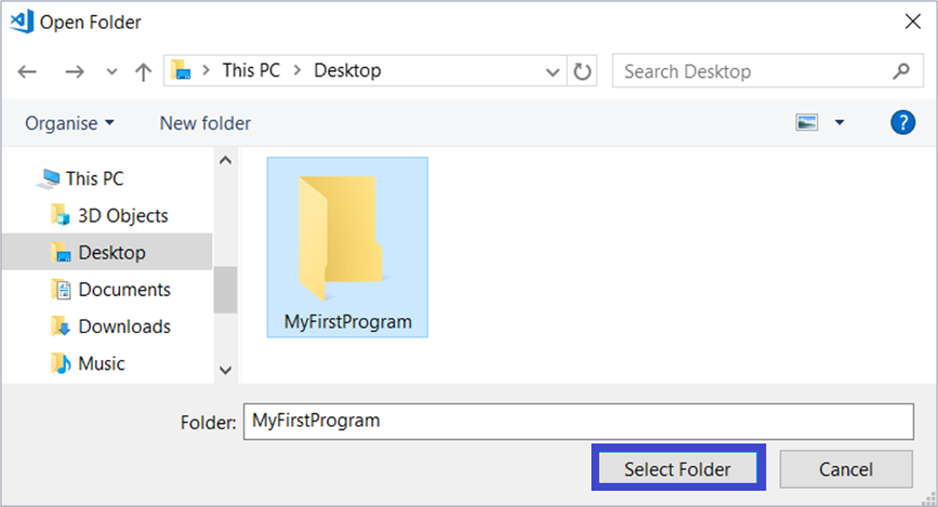
Create new project
Create and select the temporary folder in which we will create our first program

Slide 10
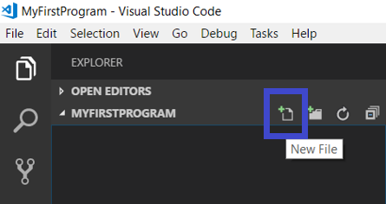
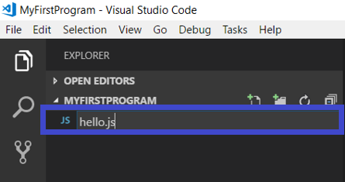
Create new project
Add a file in which we will write the code for our program The file has an extension .js

Slide 11
02
Hello World
First Application

Slide 12
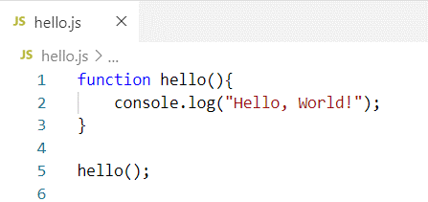
First Application
Elements of our program:
function - keyword for function
hello - the name of the function
The function has an open and closed curly bracket
The execution code is written between the innermost opening and closing curly braces.

Slide 13
Code Example
function hello(){
console.log("Hello, World!");
} hello();
Print Command
Text to be printed
Command End

Slide 14
03
Data Types & Variables
Text. Numeric Types. Variables

Slide 15
Variables
In memory, data must be stored Kept in variables They have type, name and value
let number = 100;
Initialization
name
value

Slide 16
Data Types
According to the type of information stored in the computer's memory, the data types are different:
Data types – examples:
Number: 7, 3.14, -1.5, …
String: "Hello", "Здрасти", "something" …
Boolean: true, false
Undefined – variable not assigned value
100
"Name"
3.14
true

Slide 17
Variables - Examples
We assign different data based on the type of the variable.
let number = 100;
let bigNumber = 70000000000;
let floatingPoint = 3.14;
let name = "JS";
let isValid = true;
let

Slide 18
Task
Printing Numbers.
Create a variable num.
Assign it a value of 100.
Print the value of the variable.
Repeat with another variable with a value of 3.14.
*Tip - use the code for printing "Hello, world!" (instead of the text in parentheses, use the variable name)

Slide 19
Example
function solution(){
let num = 100;
console.log(num);
}
solution();

Slide 20
04
Functions
Work with text and numbers.

Slide 21
What is a function?
The function is a named piece of code
We can perform a function when we call it
We can pass different values of the function as arguments
name
parameter
function solution(number){
console.log(number);
}
body

Slide 22
Declare and call
We declare a function with the keyword function:
We call the function by typing its name, followed by Parentheses:
function solve(number){
// Body
}
solve(5)
solve(20)
solve(5.5)

Slide 23
05
Common Mistakes

Slide 24

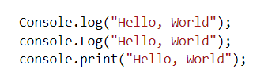
Common mistakes!
Missing quotation mark " or missing bracket ( or )
Misspelled command

Slide 25
06
Operations
Operators +, -, *, /

Slide 26
Operations
Operations with a number
function solve(a, b)
{
console.log(a + b);
console.log(a - b);
console.log(a * b);
console.log(a / b);
}

Slide 27
Operations
The result can be stored in a variable:
function solve(a, b)
{
let add = a + b;
let subtract = a - b;
let multiply = a * b;
let divide = a / b;
}

Slide 28
Task: Sum of two numbers
Write a function that calculates the sum of two numbers it receives as arguments
Solution:
function solve(a, b)
{
let sum = a + b;
console.log(sum);
}

Slide 29
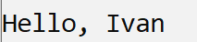
Text operations
Concatenating text with an operator " + " is called concatenation
let name = "Ivan"
let greeting = "Hello, " + name;
The result is a combination of the two texts.

Slide 30
Edge case
Concatenation of text and number
let a = 3.14;
let b = 5.35;
console.log("The sum is: " + a + b);
// The sum is: 3.145.35

Slide 31
Format Output
Task: Write a function that accepts city and degrees as parameters and displays the following message on the console: "Today in {town} it is {degrees} degrees."
Using string concatenation:
let output = "Today in " + town + " it is " + degrees + " degrees."

Slide 32
Solution
function solve(town, degrees){
console.log("Today in" + town + " it is " + degrees + " degrees.");
}
solve("Varna", 40);
solve("Sofia", 26);

Slide 33
Rounding
Round to the next (larger) integer:
let up = Math.ceil(3.14); // 4
Round to the previous (lower) integer:
let down = Math.floor(3.14); // 3
Round to a specific character:
double rounded = 3.147.toFixed(2) // 3.14

Slide 34
Task: Square Area
Write a program that calculates the square area by receiving the side as a parameter
Solution:
function solve(side)
{
let area = side * side;
console.log(area);
}

